Slide 1
Complex SDMX mapping issues for development indicators
UNSD – DFID Project on Improving the collation, availability and dissemination of development indicators (including the MDGs)
22 April 2014, Phnom Penh, Cambodia

Slide 2
Agenda for Today
CountryData Data Structure Definition (DSD)
Mapping best practices and guidelines
Review of mapping process
Complex SDMX cases
Overview of new features in DevInfo 7 Mapping Tool

Slide 3
Mapping best practices and guidelines

Slide 4
MDG / CountryData DSD Concepts

Slide 5
CountryData DSD
Single DSD used for all MDG (and other development indicators) - superset of MDG DSD
Using cross-domain concepts and codelists:
Frequency (CL_FREQ)
Sex (CL_SEX)
Age (CL_AGE) (modified)
Unit multiplier (CL_UNIT_MULT)

Slide 6
CountryData DSD
Support for diverse indicators means not all dimensions are applicable in all cases
e.g. Age Group is not applicable to indicator “Telephone lines”
Value NA is used when a dimension or attribute is not applicable.

Slide 7
CountryData DSD: Mappings
Not always obvious which values should be used in some dimensions
What should be SEX in indicator “Births attended by skilled health personnel”:
Female? Total? Not Applicable?
What about the AGE dimension?
NA
NA

Slide 8
CountryData DSD: Mappings (2)
Inconsistent mappings lead to duplications and other anomalies
In CountryData, mappings for time series are agreed before data exchange
For the MDG dataset, there has been a spreadsheet developed with the recommended mappings for each time series

Slide 9
CountryData DSD: Maintenance
CountryData codelists are maintained by UNSD
Periodically, the DSD needs to be updated
A new version of the CountryData DSD (1.4), with modified codelists, was released in January 2014

Slide 10
DevInfo 7
DevInfo 7 (Di7) launched in Nov 2012
SDMX 2.1 & 2.0 compliant
Web-based software
Most countries have migrated to version 7 from version 6
DevInfo Support Group has been adding enhancements and bugfixes; newest version is 7.1.0.1

Slide 11
Mapping to the DSD (in DevInfo)
The DevInfo mapping tool is designed to facilitate the mapping of the database to the DSD
based on mapping between the codelists of the DSD and origin database
certain situations require further manual effort to map a time series
sometimes a “fix” is required to the database where the data simply isn’t valid or where there are duplicates

Slide 12
DevInfo Data Architecture
Area, hierarchical dimension
IUS = Indicator, Unit and Subgroup
Time series data are stored with the combination of the 3 dimensions
Indicator
Unit
Subgroup: Combination of one or more sub-dimensions
Source & Time Period
Together with IUS “uniquely” defines each data value
Footnote
“Free text” field stored with data value
Notes:
IUS: Indicator Unit Subgroup
Indicator, for example:
Infant Mortality
AIDS Death
Malaria Death
Similar to SERIES in the DSD
Contains only Indicator specific values
IUS: Indicator Unit Subgroup
Unit:
Percentage
Number
USD
Square KM
Similar to UNIT of Measurement in DSD
Contains only Unit specific values
IUS: Indicator Unit Subgroup
SubGroup Dimension:
Combination of one or more sub-dimensions
“Age”, “Sex”, “Location” and “Other” sub-dimensions are set initially in database
Specific values can be created under each sub-dimension
Relate to SEX, AGE GROUP and LOCATION in DSD.
Once data exists in di7 web-based software then data can be mapped and published which conforms with the MDG DSD.
This is all done online through the di7 web-based repository through the administration profile, so let’s begin…

Slide 13
DevInfo Database
CountryData DSD
Frequency (Default = “Annual”)
Reference Area
Series
Units of measurement
Unit multiplier (Default = 0)
Location (Default = “Total”)
Age group (Default = “All Ages”)
Sex (Default = “Both Sexes”)
Source Type (Default = “NA”)
Source details
Time Period
Time period details
Nature of data points (Default = “C”)
Footnotes
Area
Indicator
Unit
Subgroup (i.e. Sex, Age, Location etc.)
Source
Time Period
Footnotes

Slide 14
DevInfo Mapping Process Review

Slide 15
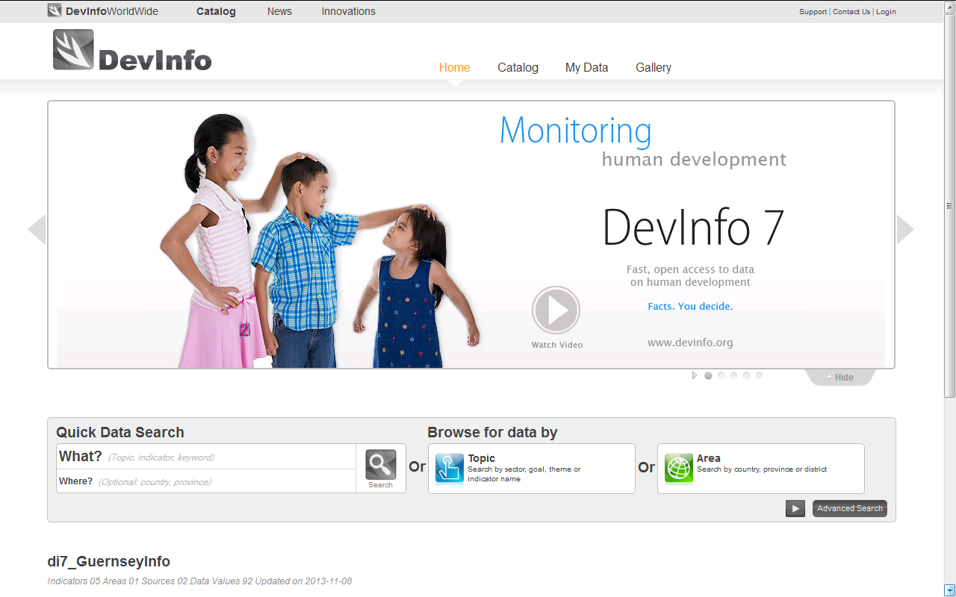
DevInfo Mapping Process Review
Go to: unstats.un.org/demoginfo1
( /demoginfo2 /demoginfo3 /demoginfo4 /demoginfo5 /demoginfo6 )

Slide 16
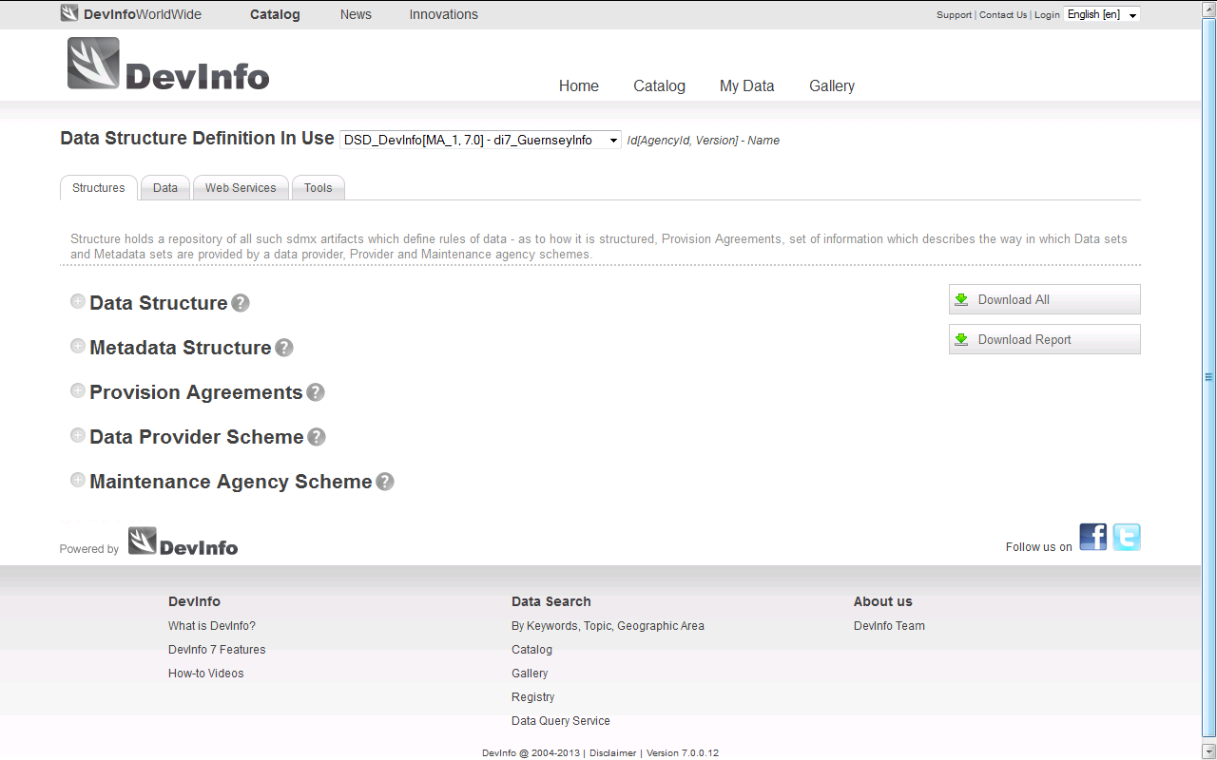
Log onto administrative profile

Slide 17
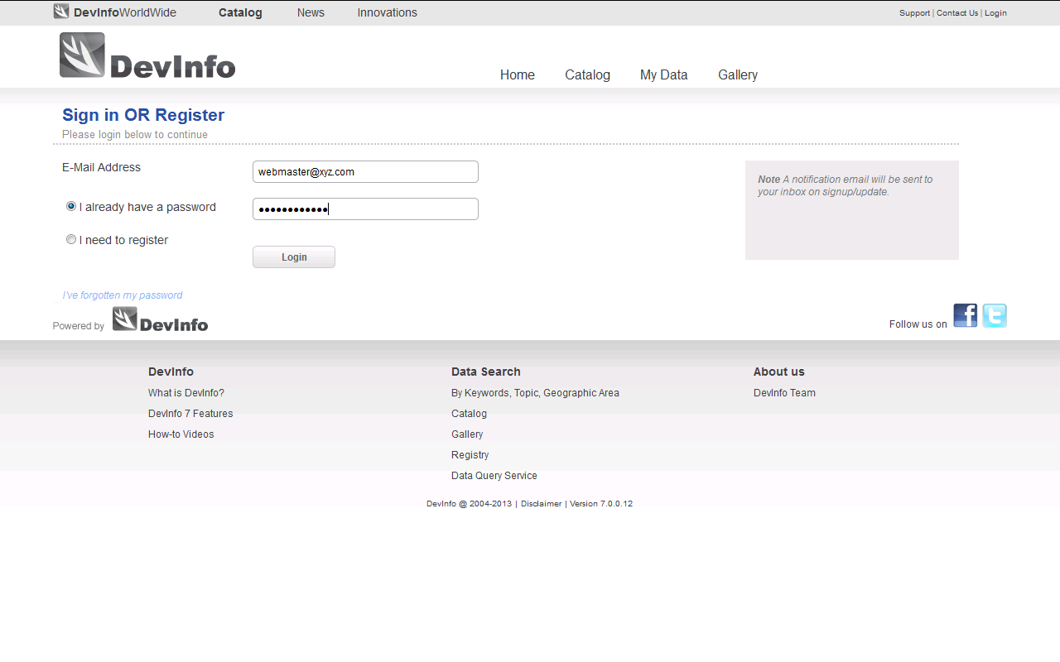
Log onto administrative profile
Username: webmaster@xyz.com
Password: 1234

Slide 18
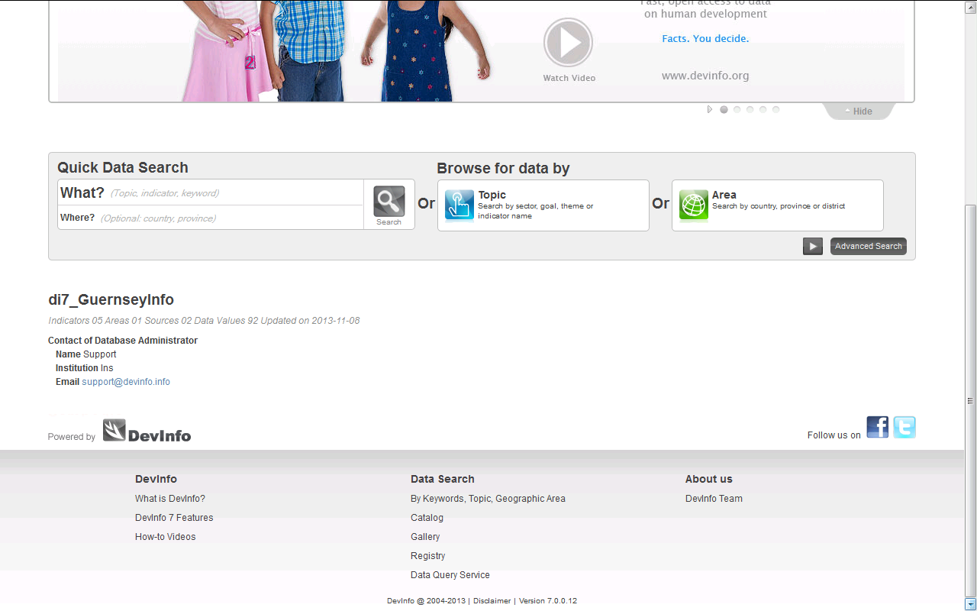
Scroll down to ‘Registry’ menu

Slide 19
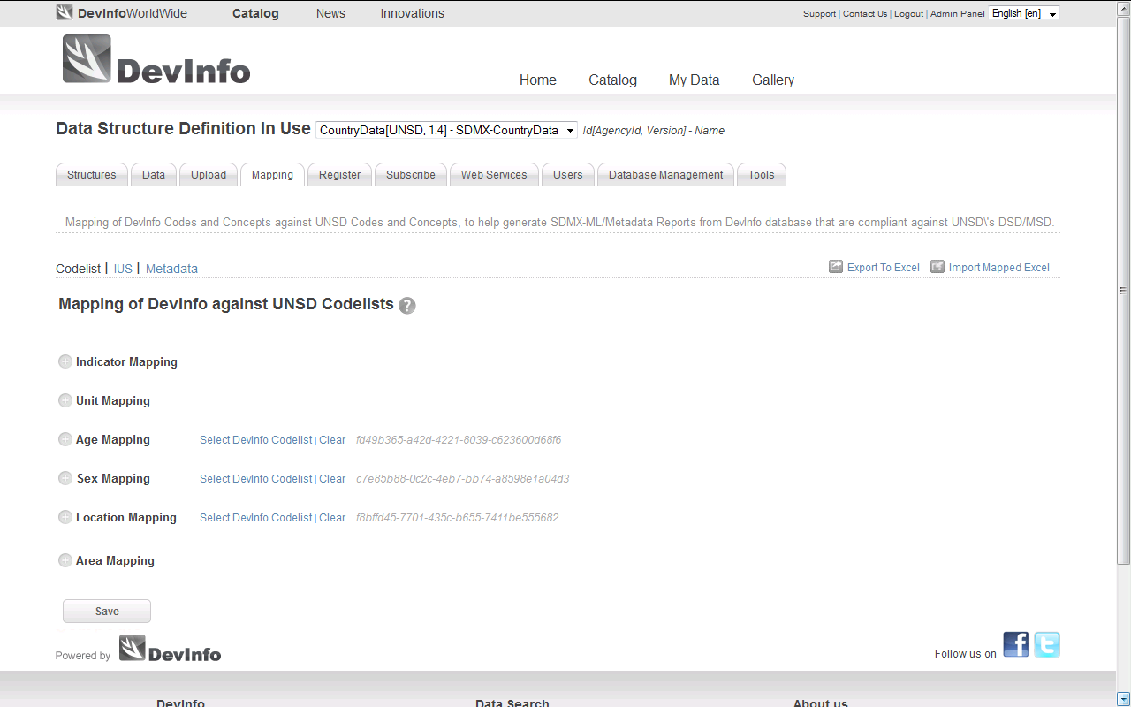
Step 1: Codelist mapping

Slide 20
Step 1: (A) Map Indicator codes

Slide 21
Step 1: (B) Map Unit codes

Slide 22
Step 1: (C) Map Subgroup codes

Slide 23
Step 1: (C) Choose Subgroup list

Slide 24
Step 1: (C) Map Age subgroup

Slide 25
Step 1: (C) Map Sex & Location

Slide 26
Step 1: (D) Map Area

Slide 27
Step 1: Save codelist mappings

Slide 28
Step 1: Ignore warning

Slide 29
Step 1: Confirm mapping saved

Slide 30
Step 1: Complete

Slide 31
Exercise 1: Codelist mapping
Use unstats.un.org/demoginfo[1-6]
Map the codelists (where possible) for:
Just one indicator, “Antenatal care coverage for at least one visit”
Unit
Age
Sex
Location
Area

Slide 32
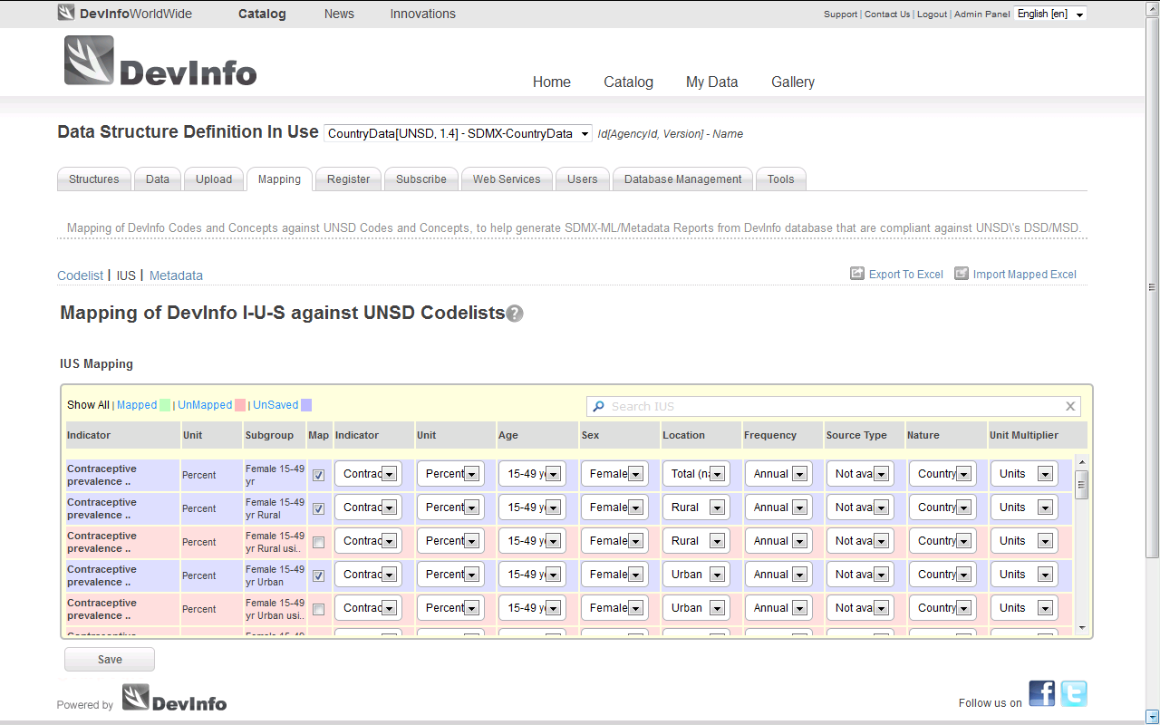
Step 2: Confirm IUS mapping

Slide 33
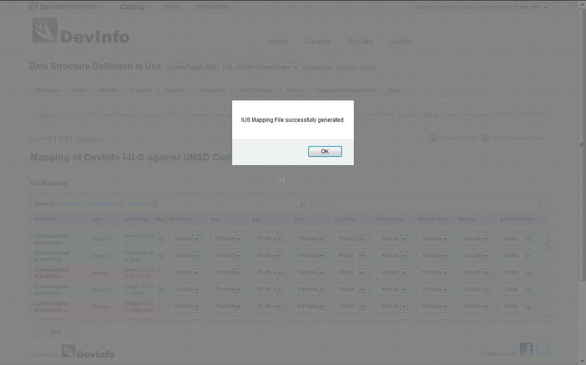
Step 2: Save IUS Mappings

Slide 34
Why is Step 2 necessary?
The default values for SEX, LOCATION or AGE GROUP mapping may not be applicable to all mappings
The codelist mapping may only provide a partial mapping of the time series (i.e. more information is required)
Any necessary mapping changes are made in Step 2

Slide 35
Where are the default values?

Slide 36
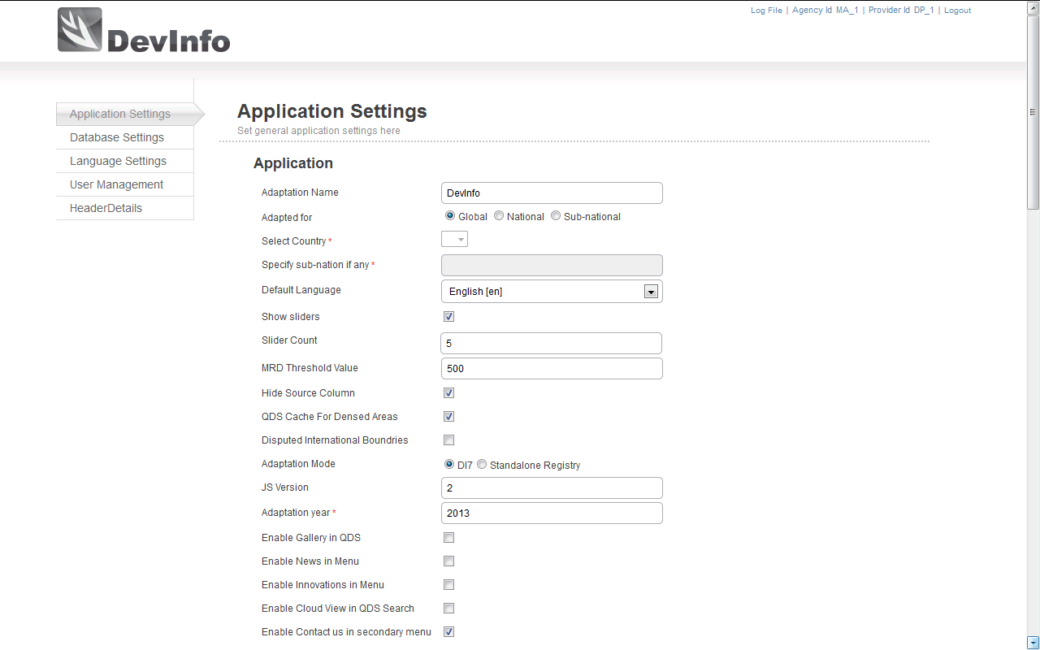
Admin panel: Application settings
Insert screens shot/details of admin panel and default value storage…
Scroll down

Slide 37
Application settings: mapping default values

Slide 38
Mapping of SUBGROUP (Defaults)
Where a subgroup value is missing the default values will apply:
Indicator
Unit
Default Values
Location = T

Slide 39
Overriding defaults in mapping of SUBGROUP
Common example of where default subgroup mappings do not apply
Indicator
Unit
Subgroups?
Default Values
Location = T
Age Group = 000_099_Y
Sex = Both sexes

Slide 40
Overriding defaults in mapping of SUBGROUP
So subgroups coverage affects the number of manual changes which have to be made…
Indicator
Unit
Subgroup for Age and Sex?
Default Values
Age Group = 000_099_Y
Sex = T

Slide 41
Overriding defaults in mapping of SUBGROUP
Using the Other subgroup to clump age, sex and location information results in more manual mapping
Indicator
Unit
?
Default Values
Location = T
Age Group = 000_099_Y
Sex = T
Subgroup for Location, Age and Sex?

Slide 42
Step 2: Amend Indicator
When using the check box to tick the mapping, you are “fixing” the mapped DSD values. If the box is unchecked again and the mappings saved, then DSD values revert to those mapped at codelist / default values (i.e. any manual changes are undone.)

Slide 43
Exercise 2: Mapping time series
Use unstats.un.org/demoginfo[1-6]
Username = webmaster@xyz.com
Password = 1234
Map the time series for
“Literacy rate of 15-24 year-olds”
“Condom use at last high risk sex (Version 2)”
“Land under forest cover”

Slide 44
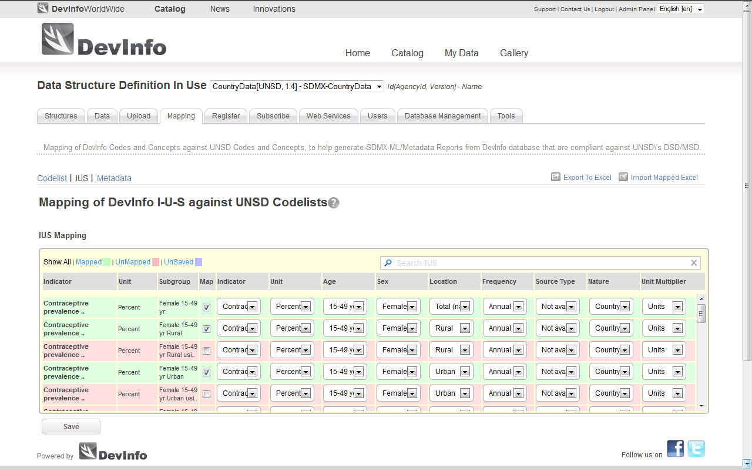
Step 2: Complete

Slide 45
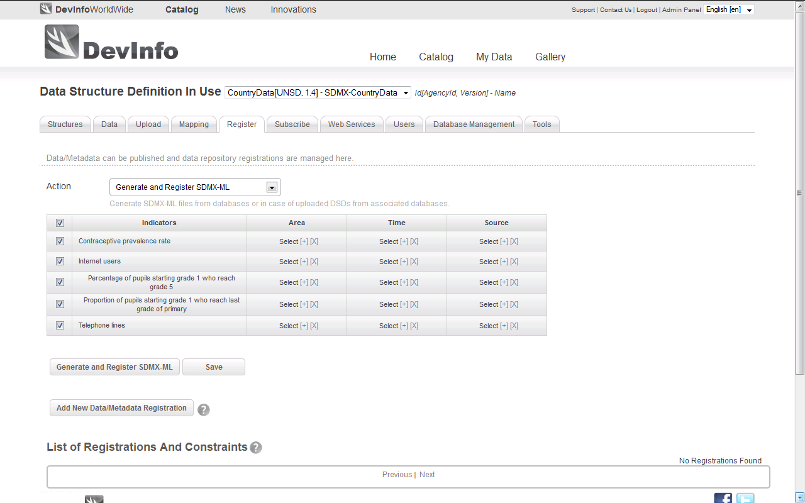
Final Step: Register mappings

Slide 46
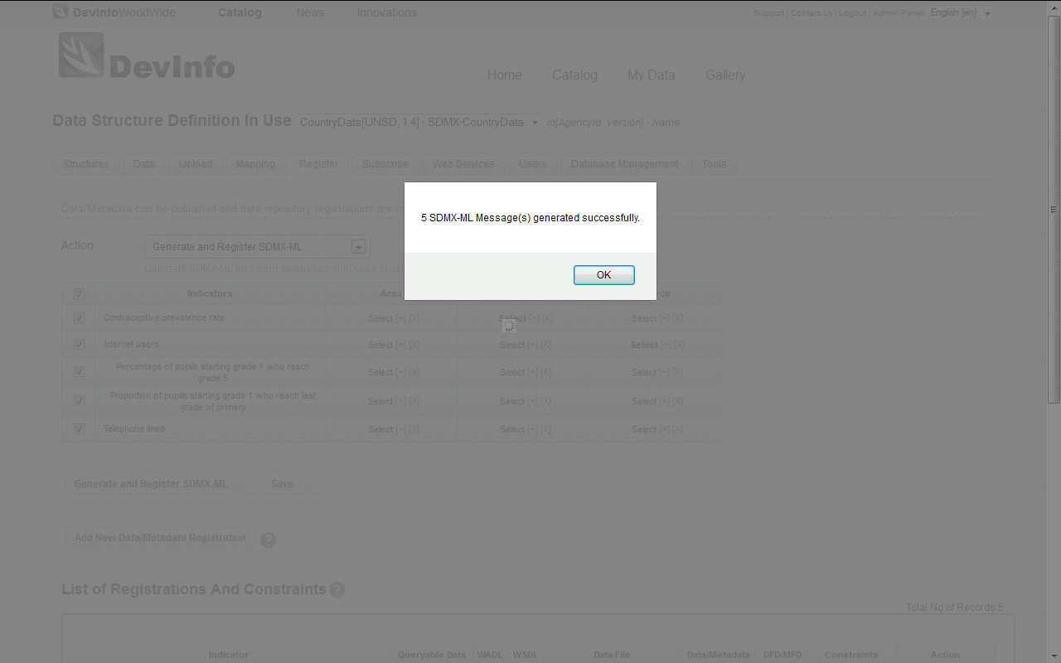
Final Step: Generate SDMX-ML

Slide 47
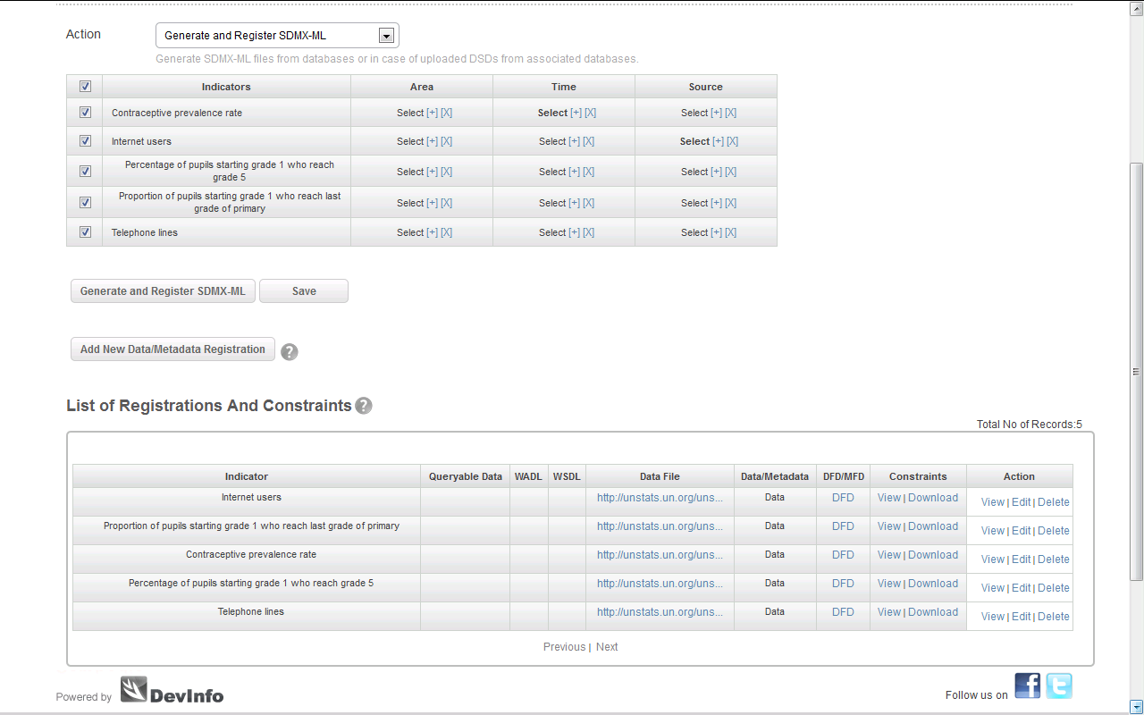
Final Step: Complete

Slide 48
Complex SDMX Cases

Slide 49
Complex mappings under the 1st and 2nd mapping steps
Most commonly mappings need to be overridden for dimensions Sex, Age Group and Location
But sometimes manual changes are required between DevInfo and DSD indicator and unit, such as when…
More than one DevInfo code relates to a single DSD code OR
More than one DSD code relates to a single DevInfo code

Slide 50
Many-to-one mapping for Indicator codelist (Example 1)
Indicator
Indicator
Indicator

Slide 51
Many-to-one mapping for Indicator codelist (Example 2)
Indicator
Indicator
Indicator

Slide 52
Many-to-one mapping for Indicator codelist (Example 3)
Indicator
Indicator

Slide 53
Many-to-one mapping for Unit codelist (Example 1)
Unit
Unit

Slide 54
One-to-many mapping of Indicator
Indicator
?
Subgroup
Manual change

Slide 55
One-to-many mapping of Indicator
?
Indicator
Unit
Manual change
Subgroup

Slide 56
“Manual” mapping of UNIT
Indicator
Unit
Manual change
Unit = “Ratio”

Slide 57
Attribute: Unit Multiplier (UNIT_MULT)
“Exponent in base 10 that multiplied by the observation numeric value gives the result expressed in the unit of measure.”
If the observation value is in millions, unit multiplier is 6; if in billions, 9, and so on. Where the number is simple units, use 0.
Mandatory attribute

Slide 58
Attribute: Unit Multiplier (UNIT_MULT)

Slide 59
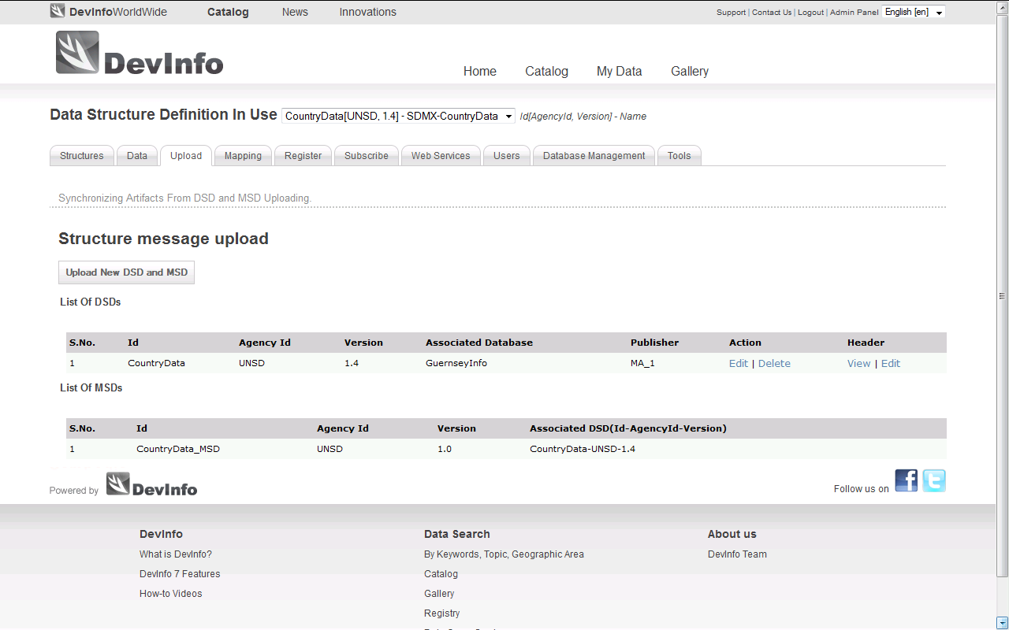
Back to mapping…

Slide 60
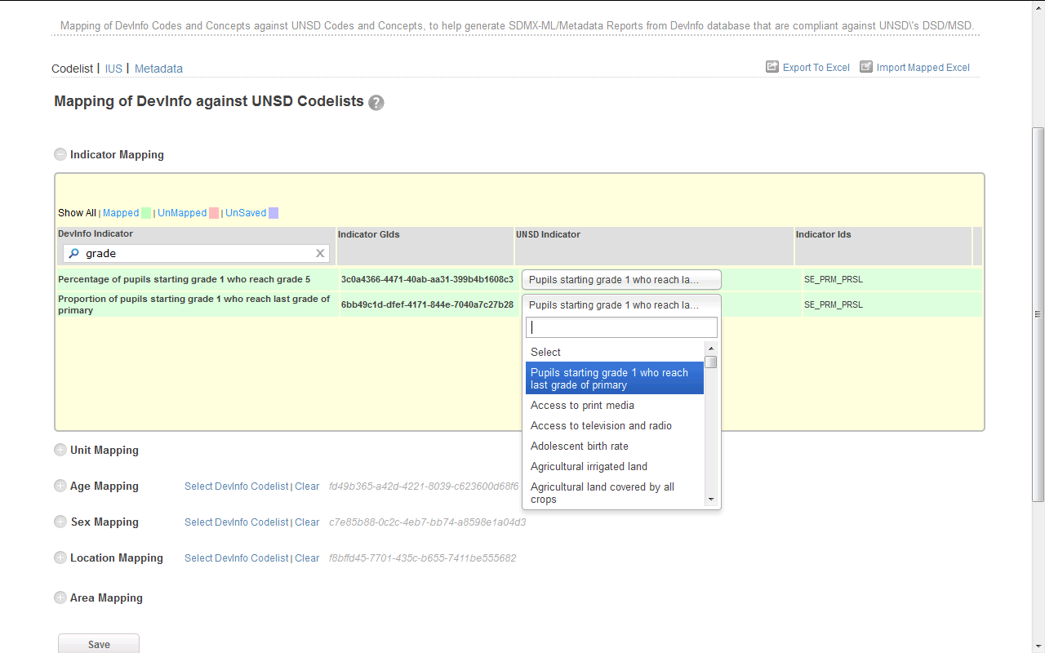
Example 1: Many-to-one mapping

Slide 61
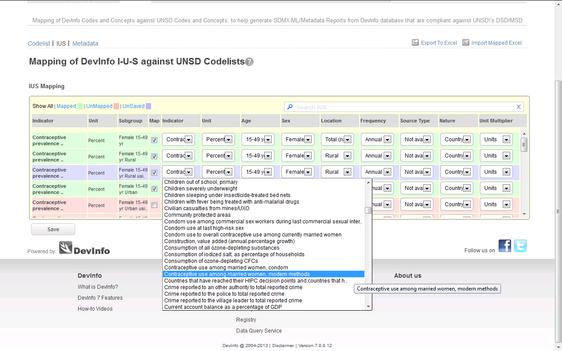
Example 2: One-to-many mapping

Slide 62
Final Step: Register new mappings

Slide 63
Exercise 3: Complex mappings
Use unstats.un.org/demoginfo[1-6]
Map/ amend/ publish the time series for:
“Gender parity index in primary education”
“Seats held by men in national parliament”
“Seats held by women in national parliament”
“Telephone lines”

Slide 64
Other issues encountered with generating SDMX from DevInfo
The CountryData DSD requires any data point to be uniquely described by the following dimensions:
However, DevInfo allows data to be stored in overlapping time intervals and with multiple sources. These issues need to be resolved to conform to the “uniqueness” required by the CountryData DSD.

Slide 65
Multiple sources
Allowable in DevInfo but not in the DSD

Slide 66
Overlapping time
This issue is only a problem where overlapping periods begin from the same year, as the mapping tool takes the first year in the period as the value for the “Time Period” dimension.

Slide 67
Targets in the database
Targets are also an issue when found in the database since they should not be exchanged as observed values

Slide 68
Target in database (Example 1)
Sometimes stored as subgroup which can be ignored at the 2nd stage…

Slide 69
Target in database (Example 2)
But other times can be found as a time period among observed values…

Slide 70
Use of filters at registration
To deal with the issues of
multiple sources for a given time period
overlapping time period beginning with the same year
targets presented alongside observed values
The registration page provides a feature to filter out data from a generated SDMX message associated with specific time periods and source references

Slide 71
Filter by time/ source

Slide 72
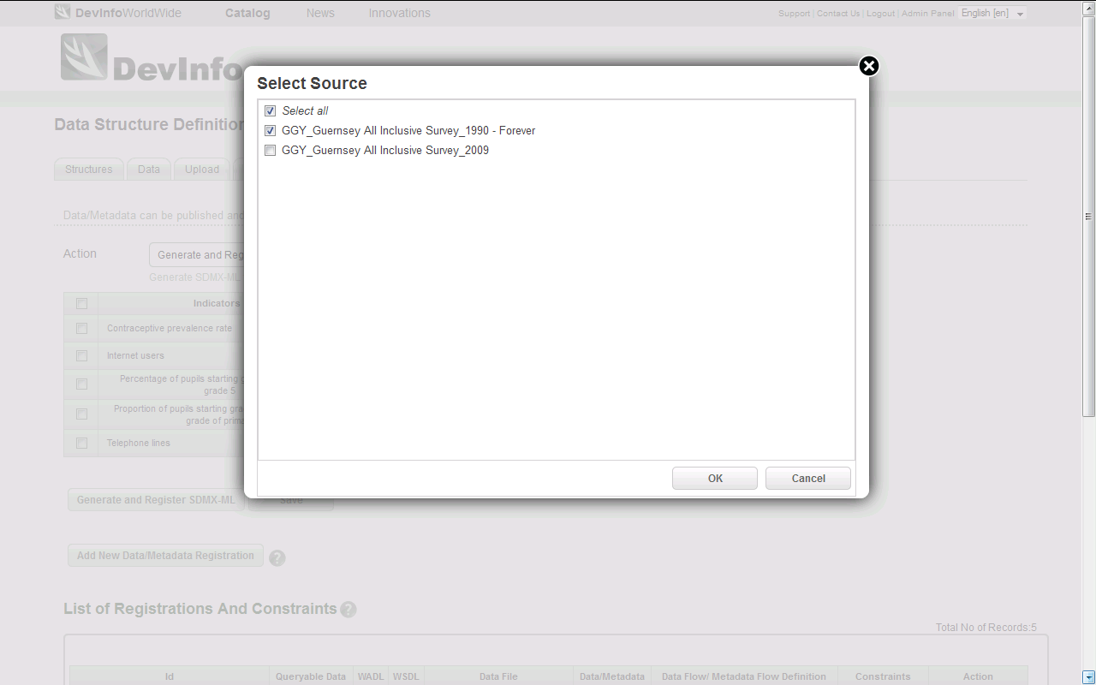
Final Step: Select source filter

Slide 73
Filter by time

Slide 74
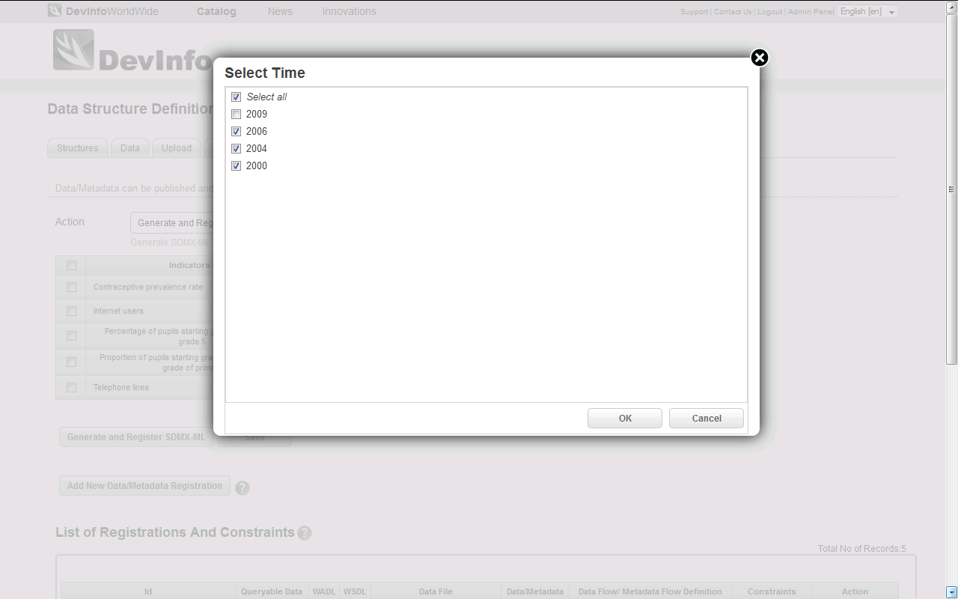
Final Step: Select time filter

Slide 75
Final Step: Register new mappings

Slide 76
Final Step: Complete

Slide 77
Exercise 4: Filter time series
Use unstats.un.org/demoginfo[1-6]
Map/ amend/ publish the time series for;
“Under-five mortality rate”
“Maternal mortality ratio (MMR)”
“Tuberculosis prevalence rate”
“Proportion of the population using improved sanitation facilities”

Slide 78
New features in DevInfo 7.1

Slide 79
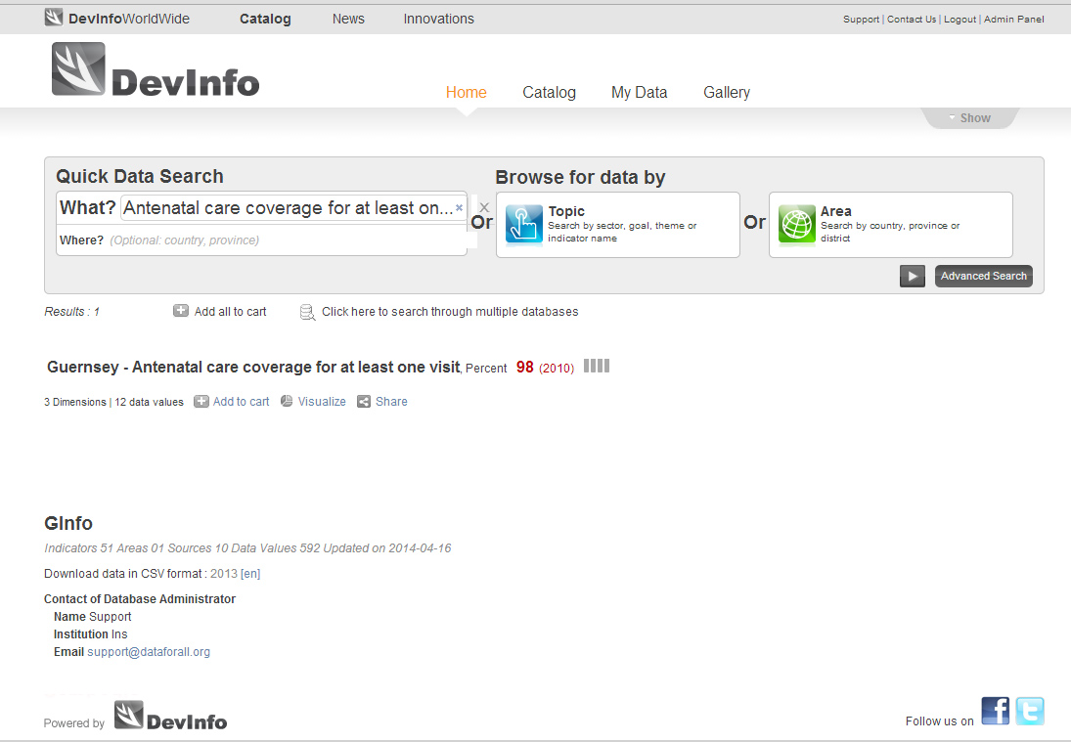
Improved Quick Data Search

Slide 80
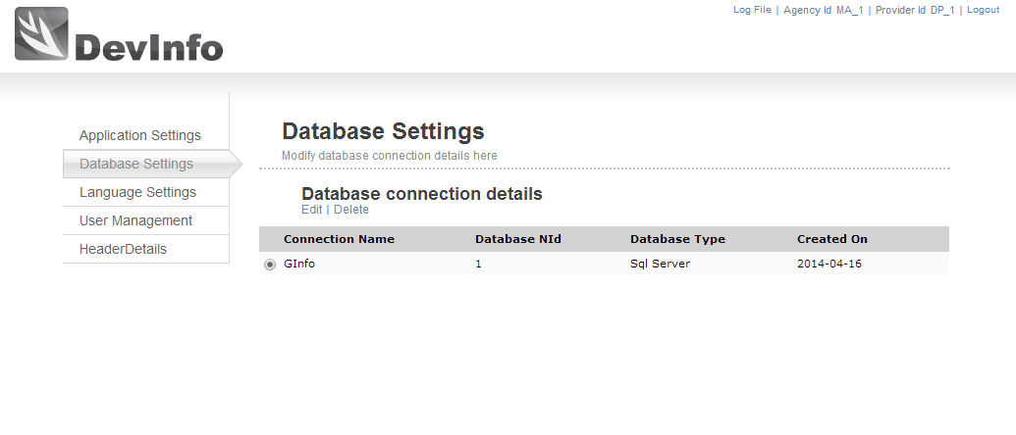
Database updates and publishing
After updating your database with new data, you can optimize and publish the updates in SDMX at the same time in Admin Panel

Slide 81
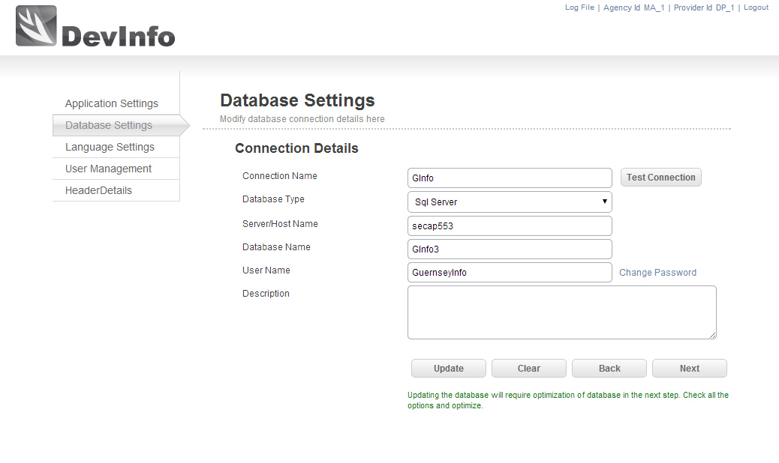
Database updates and publishing

Slide 82
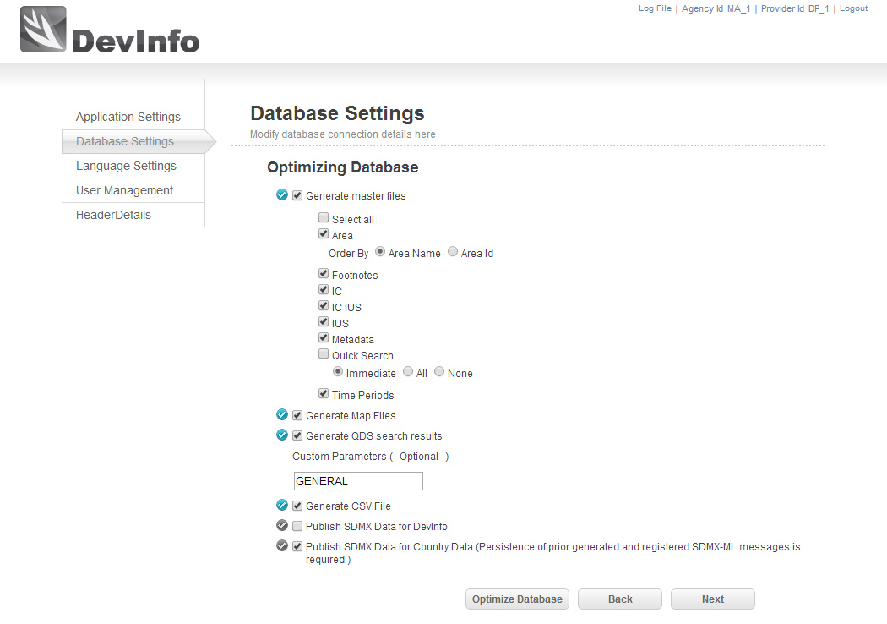
Database updates and publishing

Slide 83
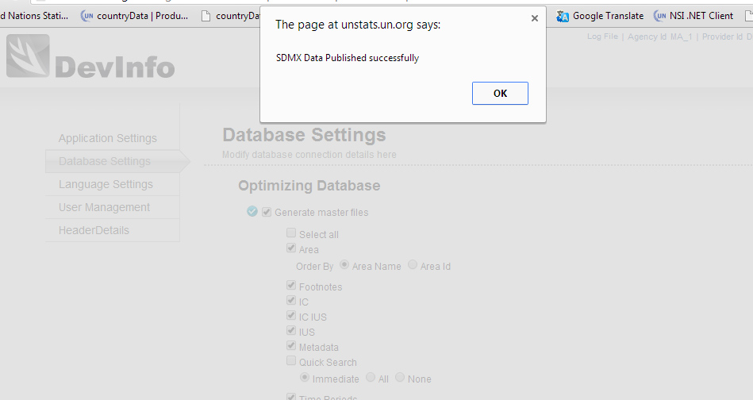
Database updates and publishing

Slide 84
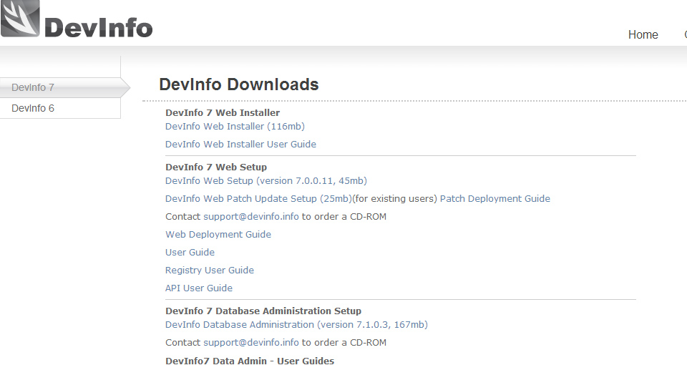
DevInfo installation and upgrading
The latest version of DevInfo is 7.1.0.1
Starting with this version, you no longer need to uninstall and reinstall in order to upgrade
Instead you will use patches available on the DevInfo Downloads page

Slide 85
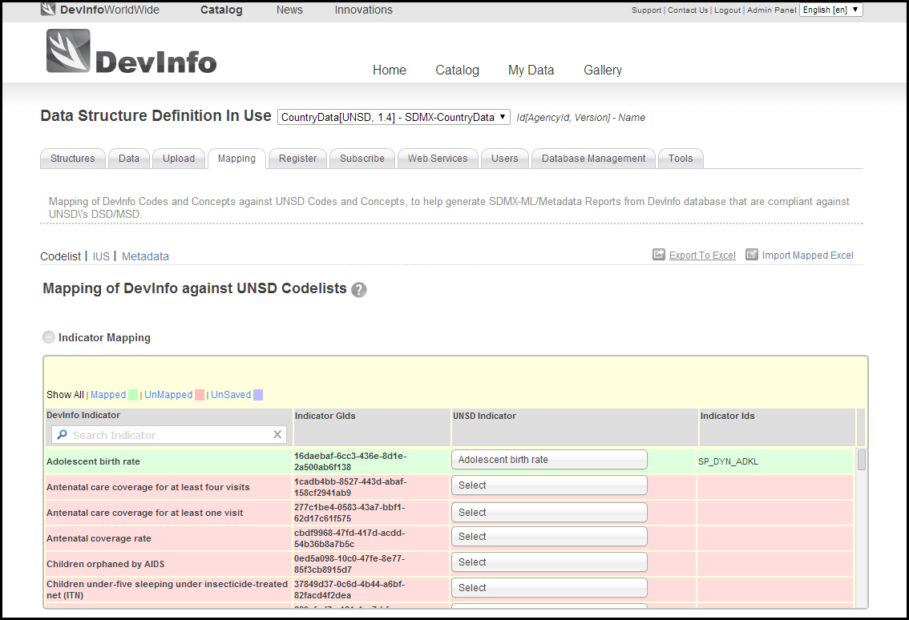
Exporting and importing mappings

Slide 86
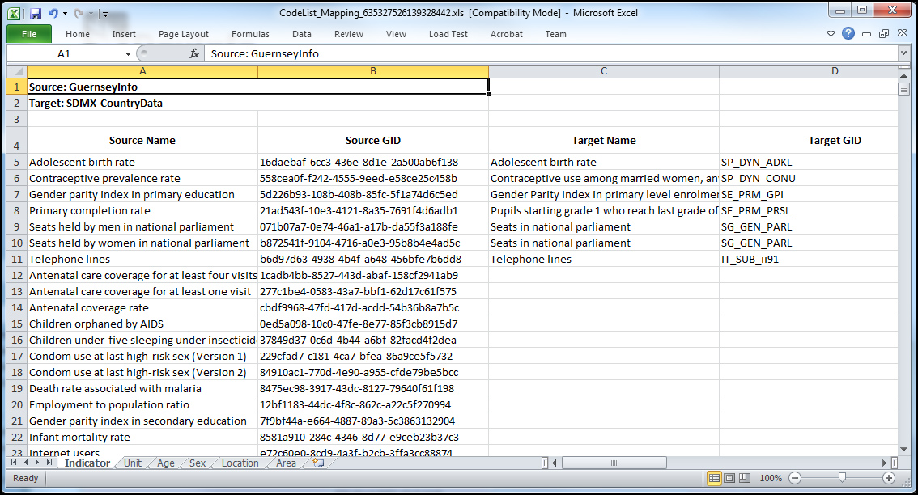
Exporting mappings

Slide 87
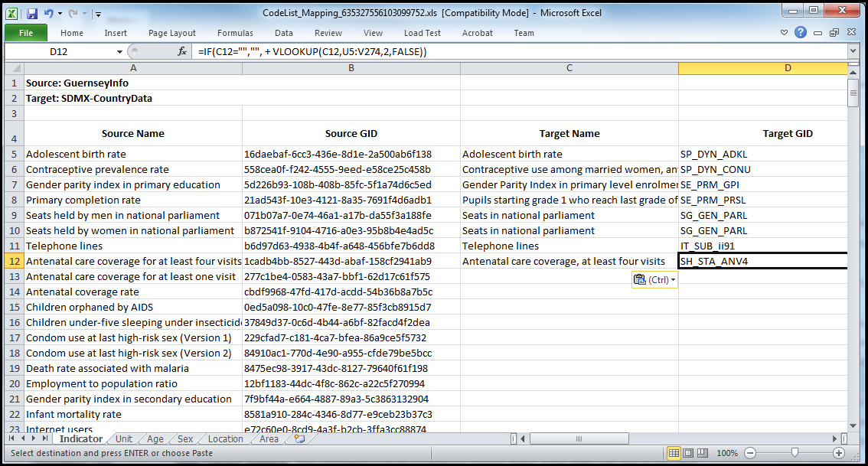
Editing exported mappings

Slide 88
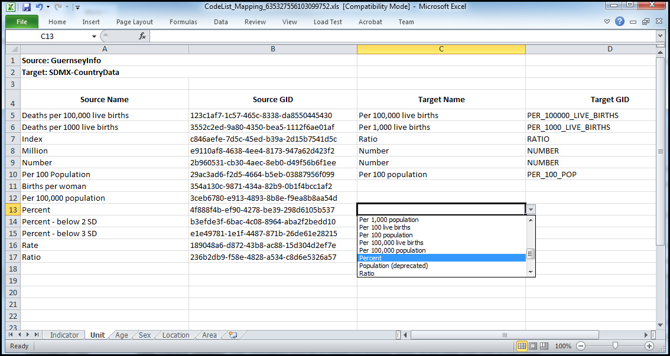
Editing exported mappings

Slide 89
Exporting and importing mappings

Slide 90
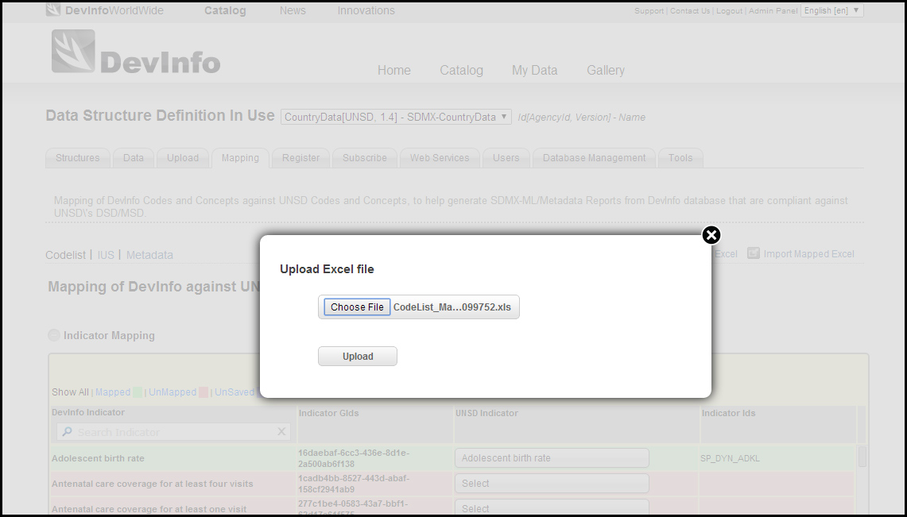
Importing edited mappings

Slide 91
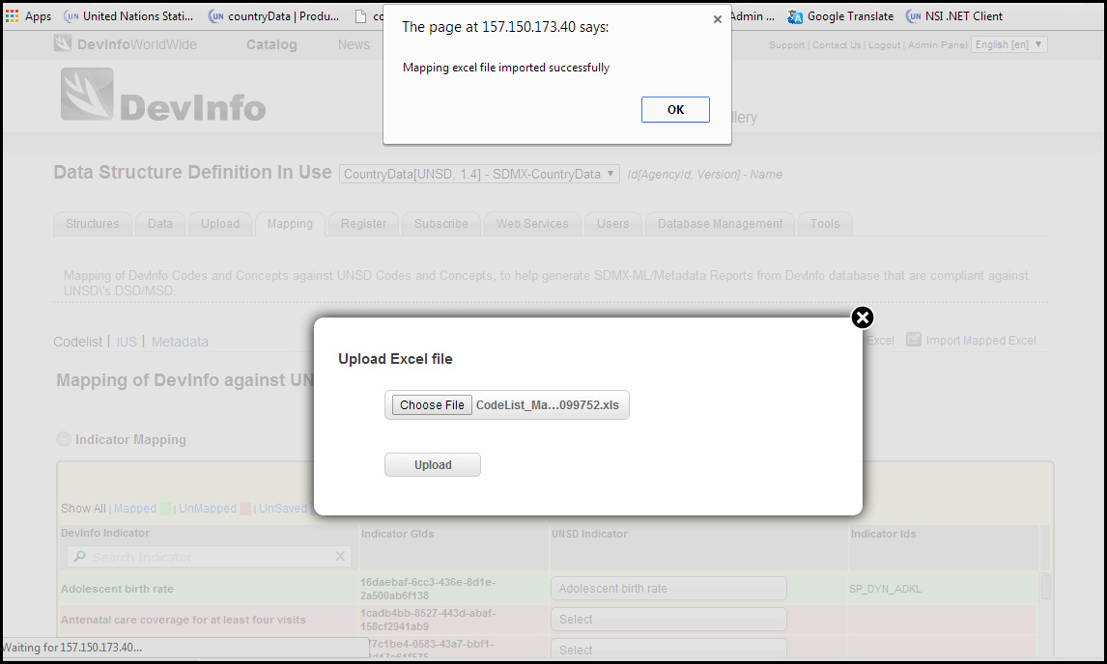
Importing edited mappings

Slide 92
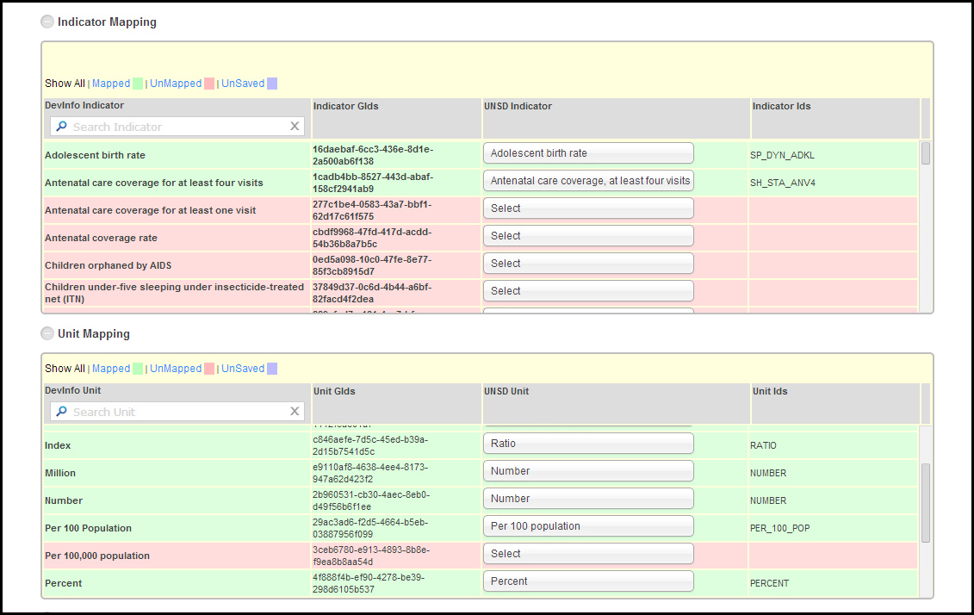
Importing edited mappings

Slide 93
Thank you for your attention

